Slide 1
Day 1

Slide 2


Slide 3


Slide 4

Notes:
https://www.atlassian.com/whitepapers/devops-survey-2020

Slide 5
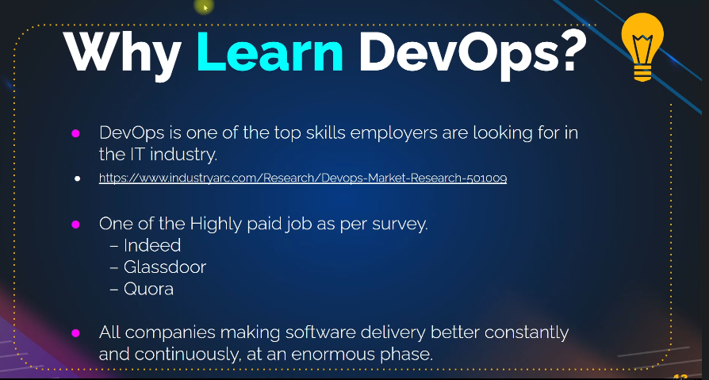
Notes:
https://www.industryarc.com/Research/Devops-Market-Research-501009
https://www.atlassian.com/whitepapers/devops-survey-2020

Slide 6
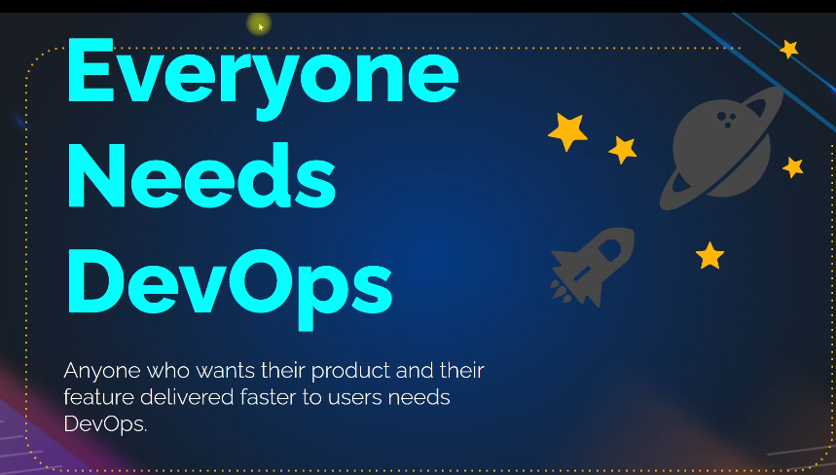

Slide 7
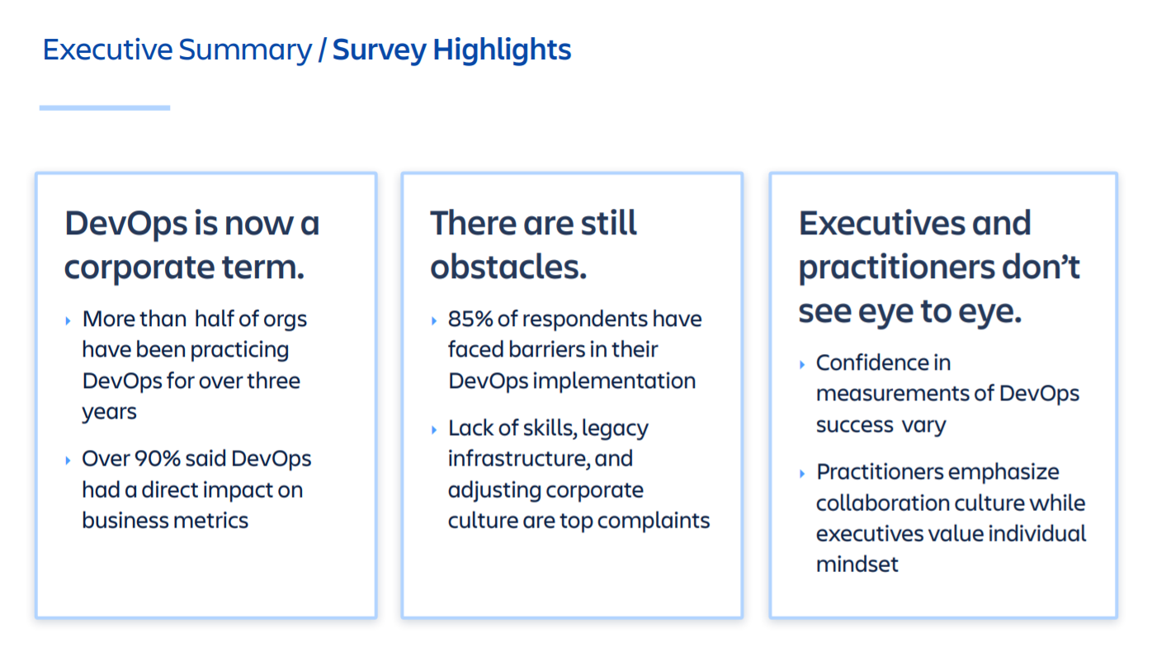

Slide 8
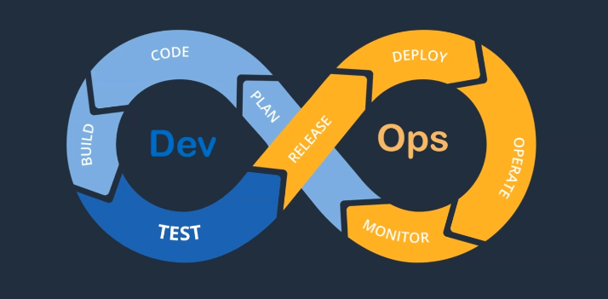

Slide 9
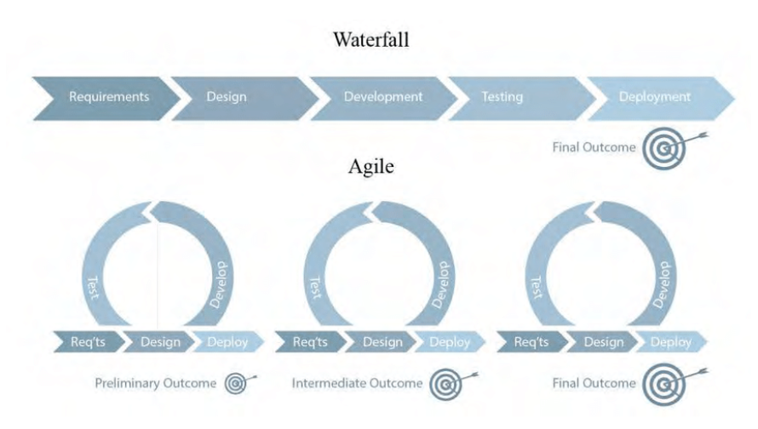
Notes:
https://docs.google.com/document/d/1e1nV5BRCGddpx3zH0pilRJKeqTnV3Ye1y3t2Wer3fNQ/edit?usp=sharing

Slide 10


Slide 11
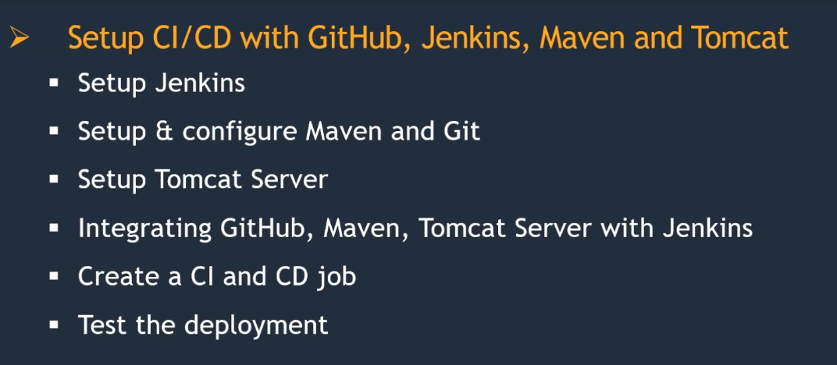

Slide 12
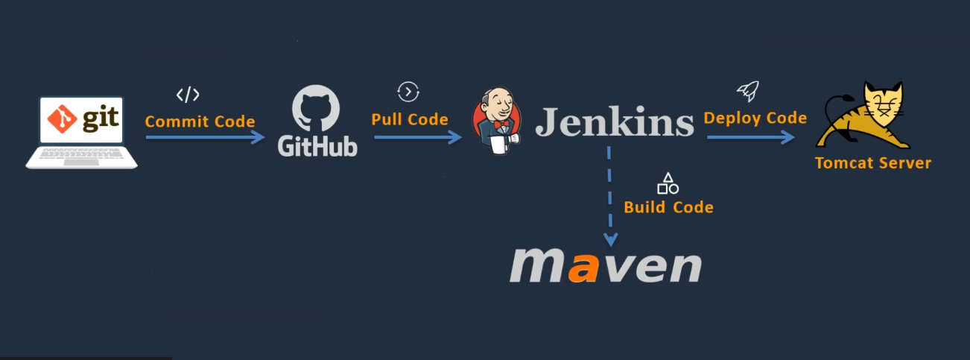

Slide 13
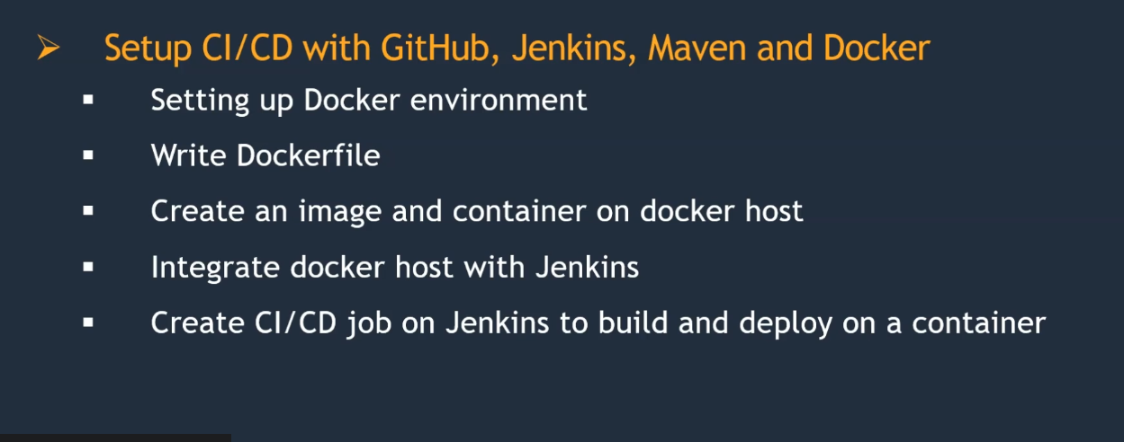

Slide 14
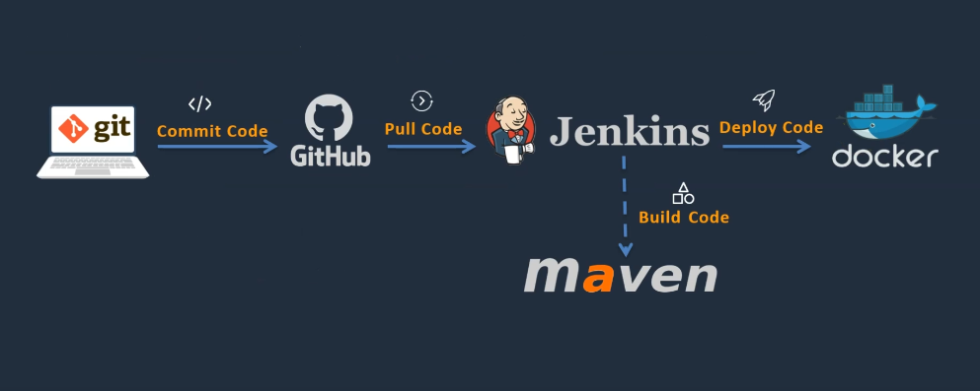

Slide 15
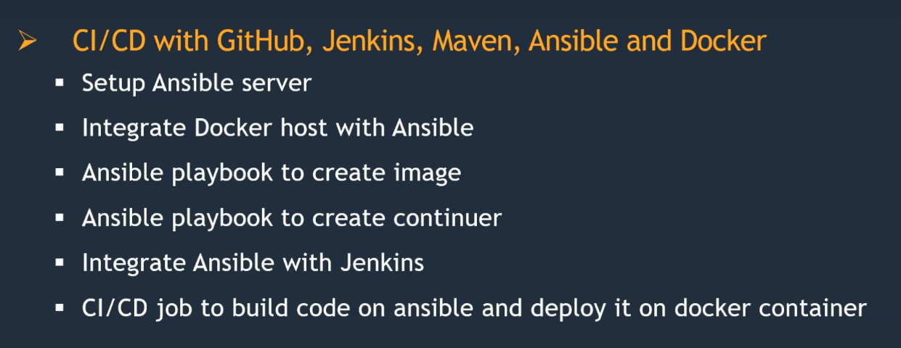

Slide 16
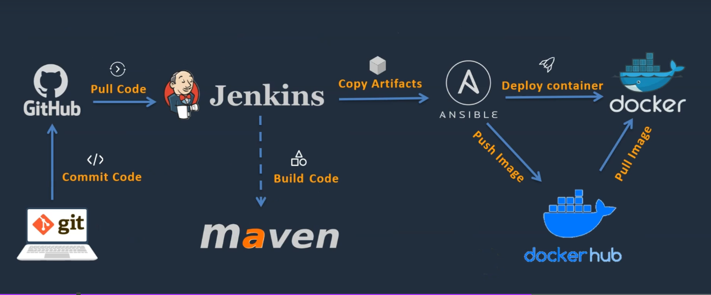

Slide 17
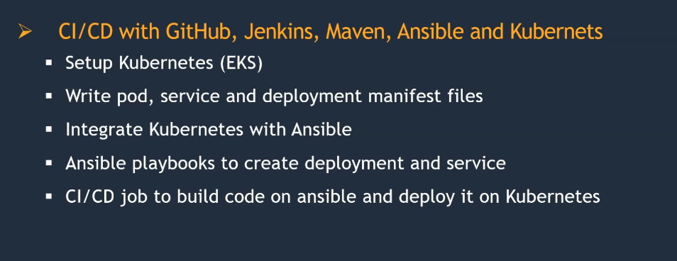

Slide 18
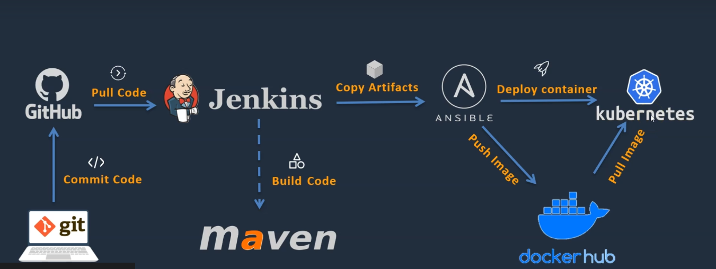

Slide 19
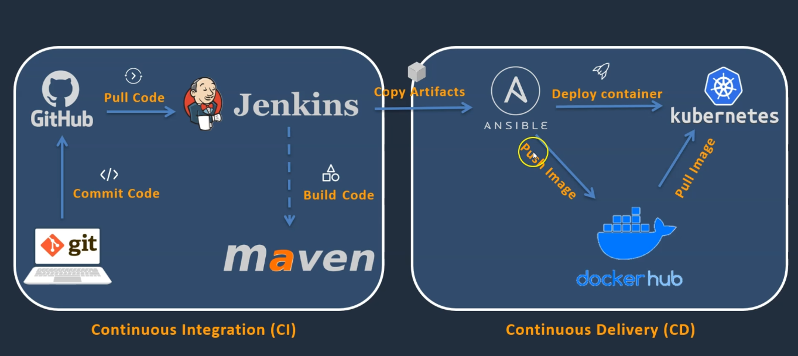

Slide 20
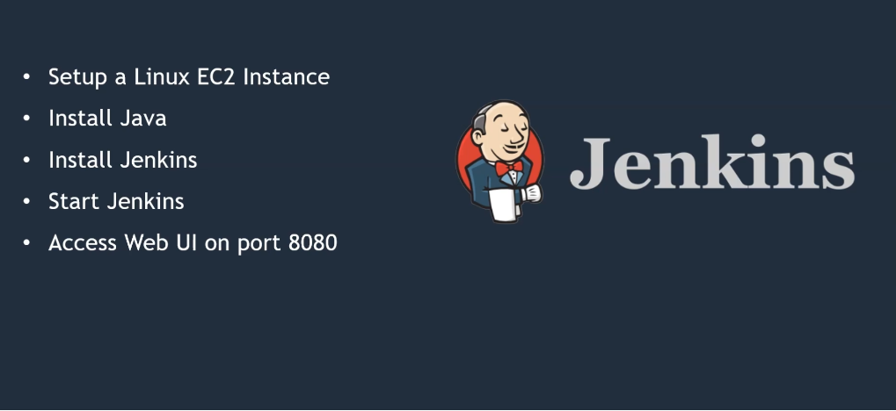

Slide 21
Day 2

Slide 22
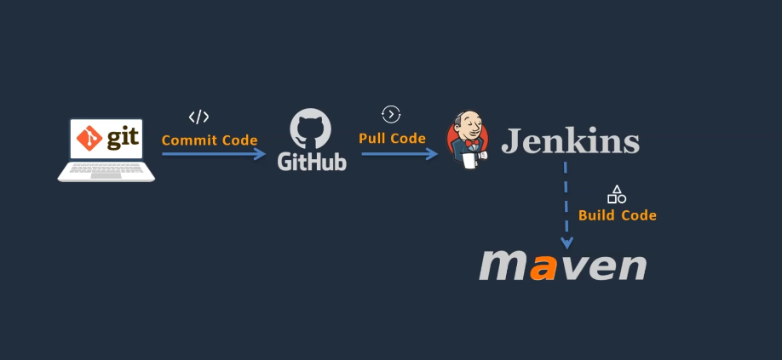

Slide 23
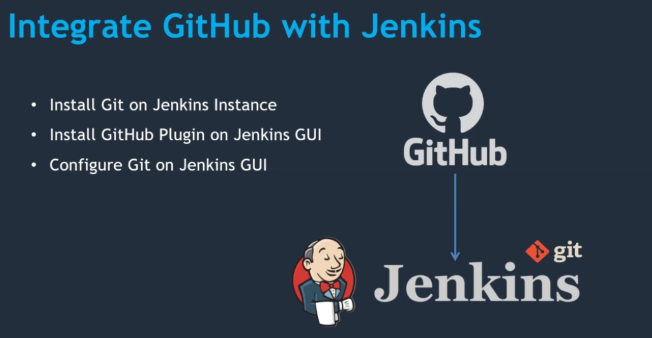
Notes:
https://github.com/ikaudanaveen/hello-world

Slide 24
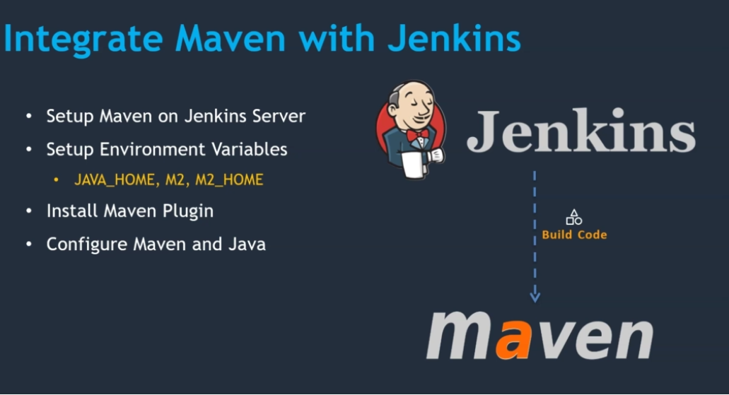
Notes:
https://maven.apache.org/install.html
https://maven.apache.org/guides/introduction/introduction-to-the-lifecycle.html

Slide 25
Thank You

Slide 26
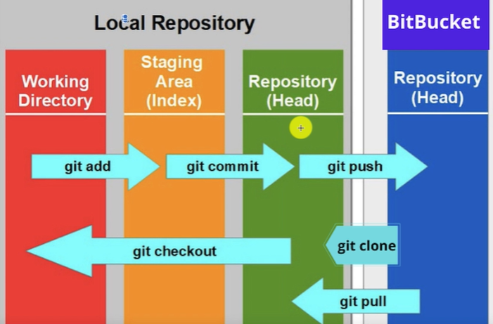

Slide 27
Day 3

Slide 29
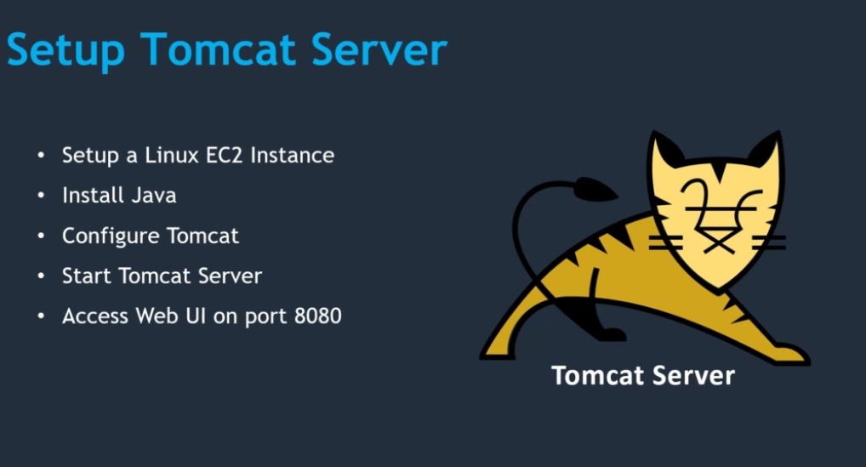
Notes:
https://github.com/ikaudanaveen/Simple-DevOps-Project/
https://github.com/ikaudanaveen/hello-world

Slide 30
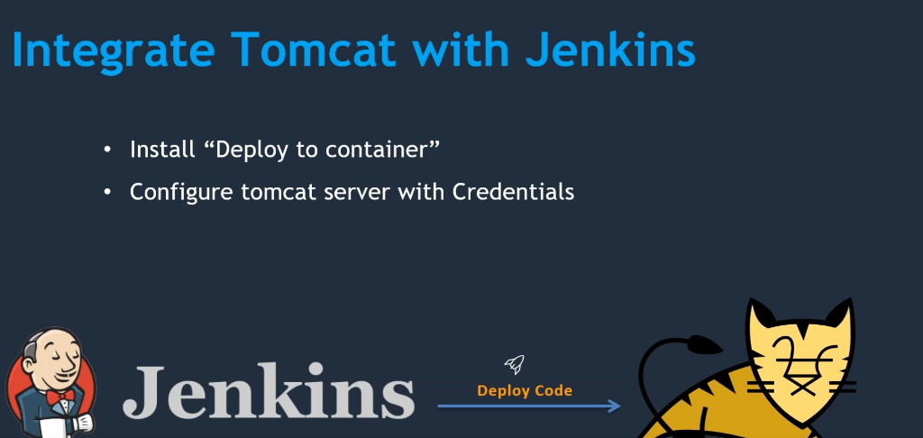

Slide 31
Day 4

Slide 32
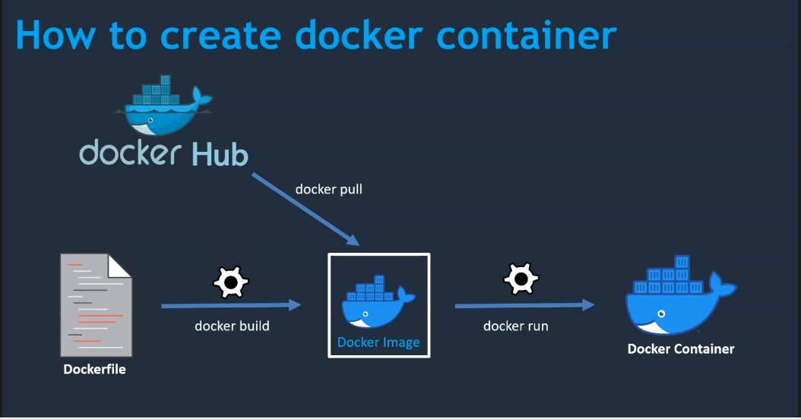

Slide 33
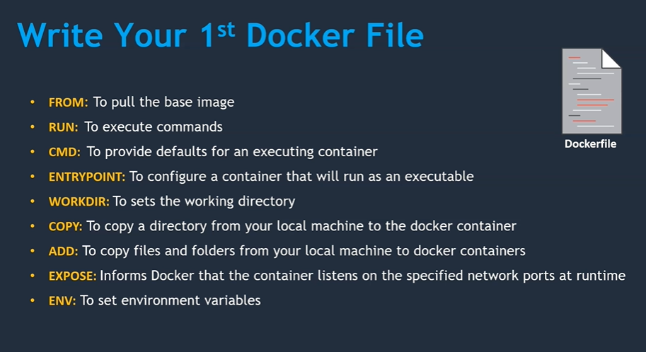

Slide 34
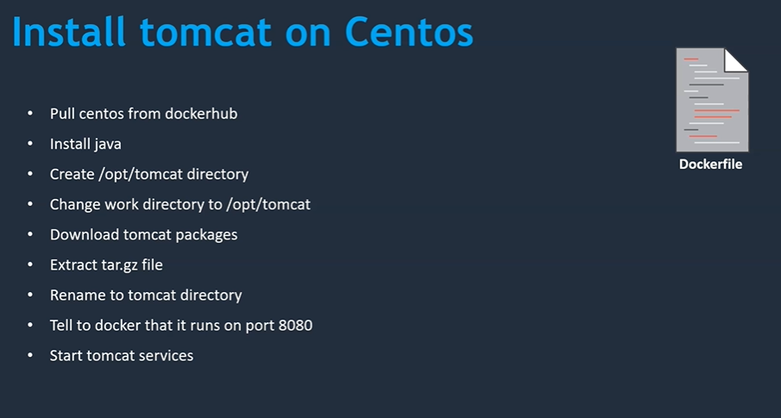

Slide 35
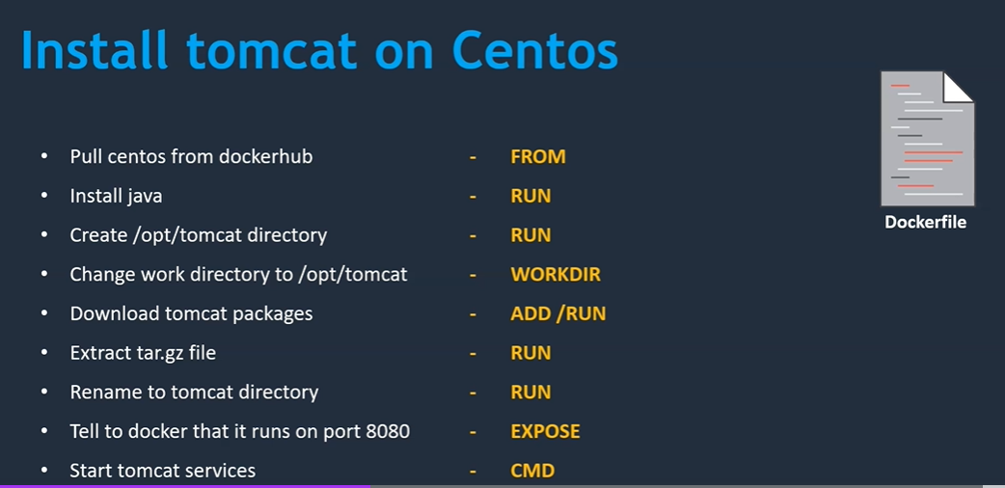

Slide 36
Day 17

Slide 37
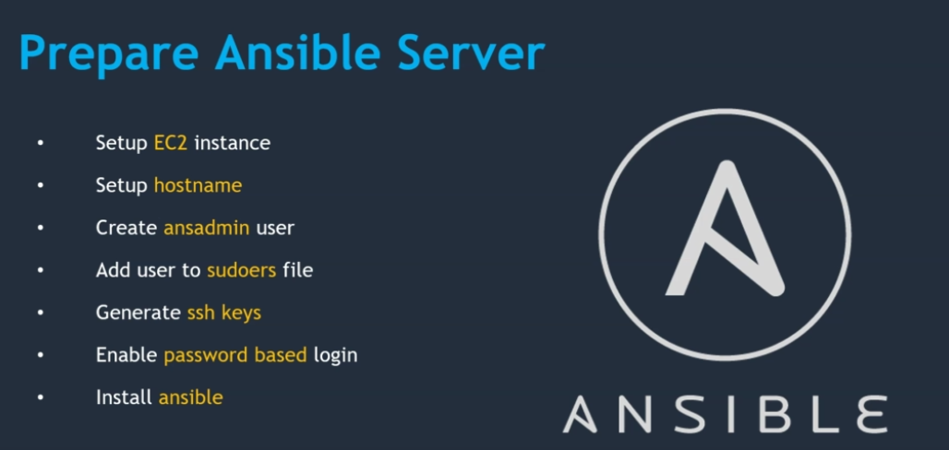

Slide 39
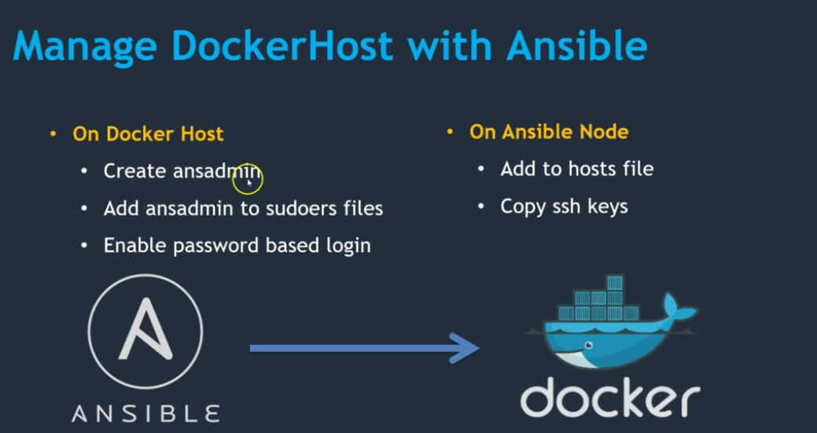

Slide 40
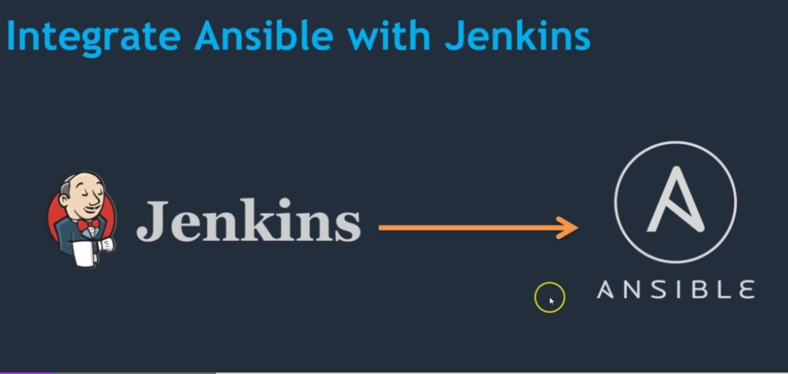

Slide 41
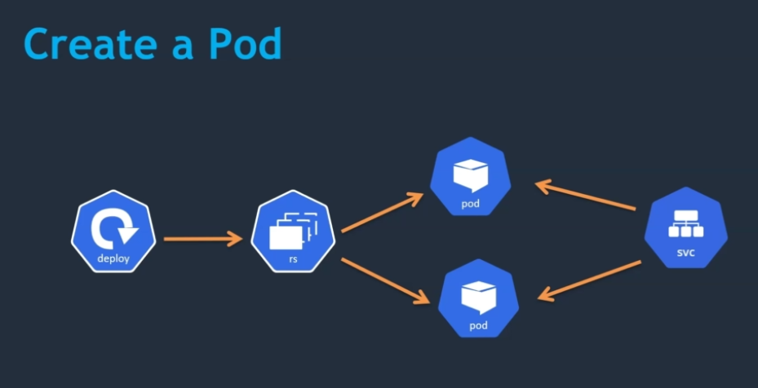

Slide 42
Questions

